Slide 1

Geospatial and Earth Observation Data for the SDGs
GEO Week 2017
Aditya Agrawal
Director, Data Ecosystems Development
October 2017
1

Slide 2


The Global Sustainable Development Goals
MDGs
(2000-2015)
SDGs
(2015-2030)
Developing country focused
Universal
Social
Social, Economic, and Environmental
Foreign Aid
Domestic Investment, Private Flows, and Aid
Official Statistics and Administrative Data
Big Data, Citizen Generated Data, Geospatial and Earth Observation Data, Open Data, and more
2

Slide 3

17 Goals, 169 Targets, 230 Indicators = Huge Data Needs

Slide 4
THE CHALLENGES:
Data are not available, dynamic, disaggregated, high quality, useable, accessible, open, or used effectively.
Data on entire groups and key issues are unavailable.
Data are not dynamic or disaggregated.
Data quality is poor and major gaps remain.
Data that exist are often not useable.
Data that are useable are not accessible or open.
Data that are accessible are often not used effectively.
  DATA CHALLENGES LEAVE TOO MANY BEHIND
4

Slide 5
DATA FOR WHAT?
Improved Decision-Making and Policy
Increased Citizen Empowerment
Increased Innovation and Entrepreneurship
To Achieve and Monitor
Sustainable Development
5

Slide 6
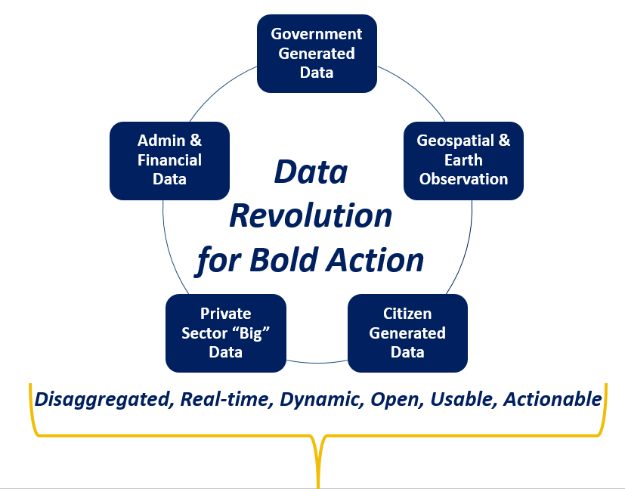
  Harnessing the Data Revolution
“Data is the Oil of the 21st Century”
Supporting and complementing government and civil society efforts to generate data for statistics for the formal SDG monitoring framework
Unleashing innovation in production, accessibility and use of real-time, dynamic, disaggregated data from multiple sources
6
Notes:
And it’s happening along two major tracks. 1) it supports and complements efforts already underway to generate data for statistics for the formal SDG monitoring framework; and 2) unleashing innovation on the use of real-time, dynamic, disaggregated data from multiple sources

Slide 7

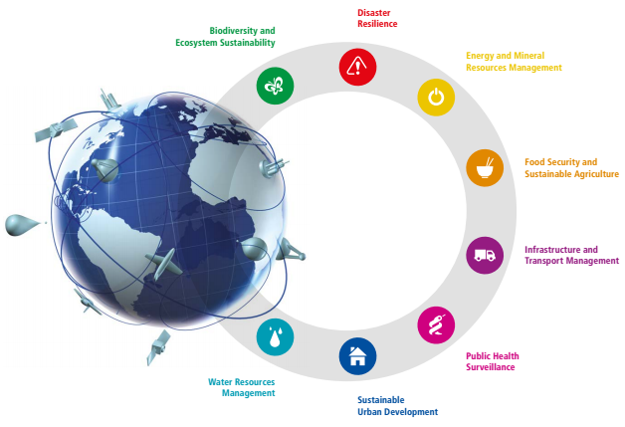


  Earth Observation Data

Slide 8
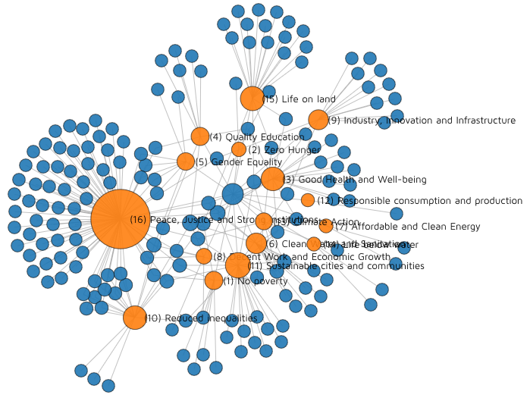

  Citizen-Generated Data
http://staging.winguweb.org/2015/datashift/
8

Slide 9
  Privately Held (Big) Data
ex: Provide mobility information every hour for security staffing
ex: Provide real-time personal health risk to users in mobility
Faster:
monthly…daily…
« Real Time »
Operation
Management
Customer Time (Velocity)
ex: Optimise hospital location for density of population
ex: Optimise distribution of drugs in function of diseases geography, calendar events,…
Policies &
Consulting
SLOWER
Data refresh
(yearly, quarterly)
Single Data
source
Multiple data
sources
9
Variety of Sources for Data Analysis
9

Slide 10
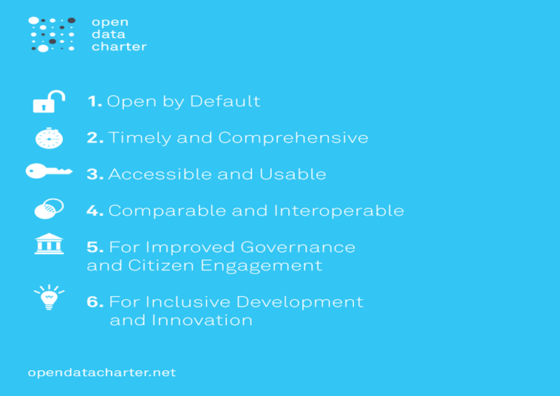
  Open Data
10
Notes:
The Six Principles at a glance.

Slide 11
better, more accessible, and usable data to help end poverty, fight inequality and injustice, and combat climate change.
WE CONVENE
WE CONNECT
WE CATALYZE…
11
Notes:
Put the

Slide 12
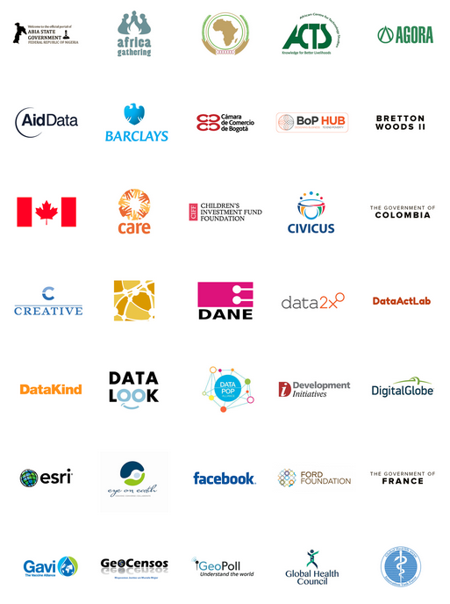
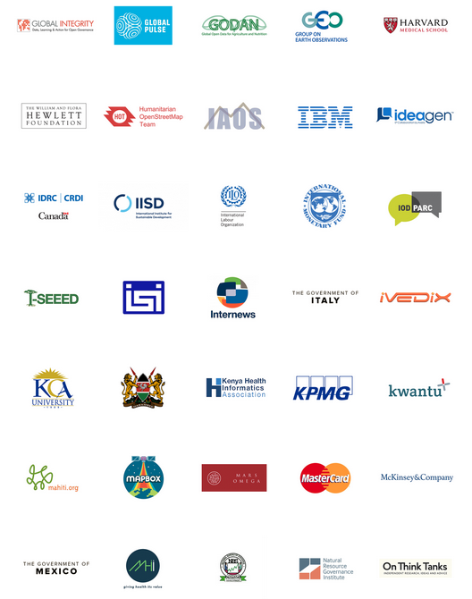
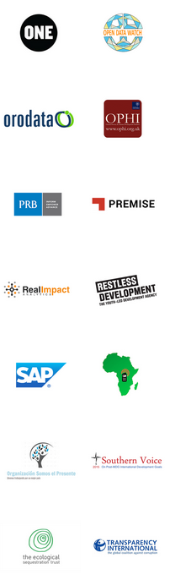
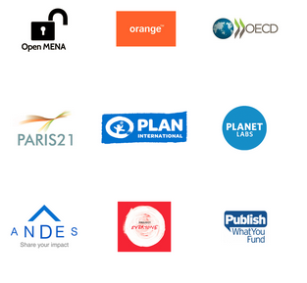
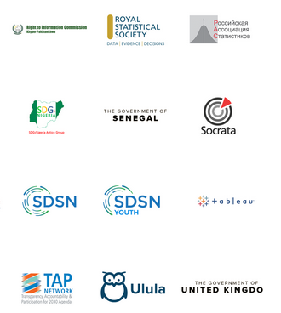



The Global Partnership has 200+ Data Champions
12

Slide 13









Harnessing the data revolution for sustainable development
Enablers: Political Environment
Showcase how data can remove political and social barriers, and address data gaps
Stimulate collaboration between public-private actors in support and tracking of the SDGs
Demand Side
Supply Side
Drive awareness and political buy-in on how and why data makes a difference
Ensure visibility and under-standing of data for filling gaps and decision making
Harness real time data flows for sustainable development
Ensure access to data in public domains; including open data
Catalyse data innovations for the delivery of the SDGs
Opportunities
Enablers: Structural Environment that fosters trust
Forster private sector engagement to address market failures by providing expertise and knowledge
Support the establishment of fair use of data
Foster mechanisms to improve access and interoperability that enables widespread usage of SDG data

Slide 14
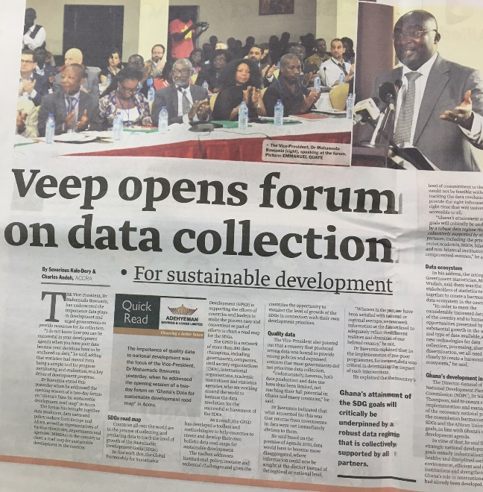
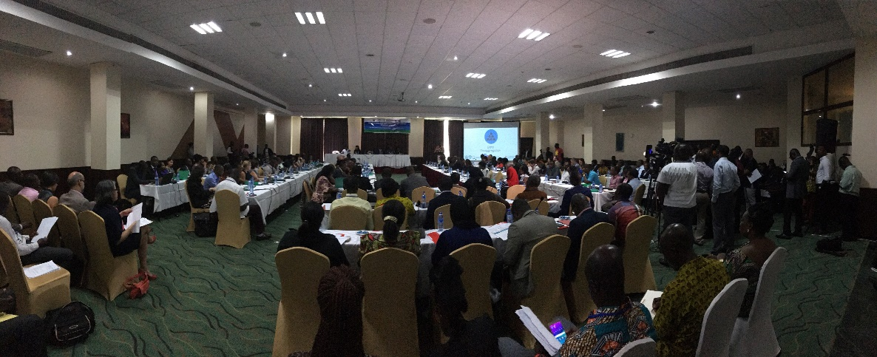
Data Roadmaps for Sustainable Development
Support countries at national and sub-national levels to develop and implement whole of government and multi-stakeholder data roadmaps for harnessing the data revolution for sustainable development, with particular emphasis on the SDGs and local priorities articulated in national plans.

Slide 15
Country Led Approaches
The Data Roadmaps for Sustainable Development approach is iterative, based on experiences and implementation models from partner countries
  Colombia
  Philippines
  Sierra Leone
  Kenya
  Tanzania
  Senegal
  USA
  Ghana
SDG Goals and Targets
National Plans and Priorities
Localized Framework

Slide 16

Data for Action
Official Data for Planning and Monitoring
Geospatial Data
Citizen Generated Data
Privately Held Data
Open Data
More informed and data driven decision making
Fill data gaps more efficiently, frequently and cost effectively
Real-time, dynamic, disaggregated data
Official and non-official data
Use innovative approaches and range of stakeholder to solve problems

Slide 17
Assessment on Colombia’s information availability for global SDG indicators
Available Information: 54%
Partial Information, need of improvements: 30%
Not data or not methodology : 16%
Source: DANE.

Slide 18
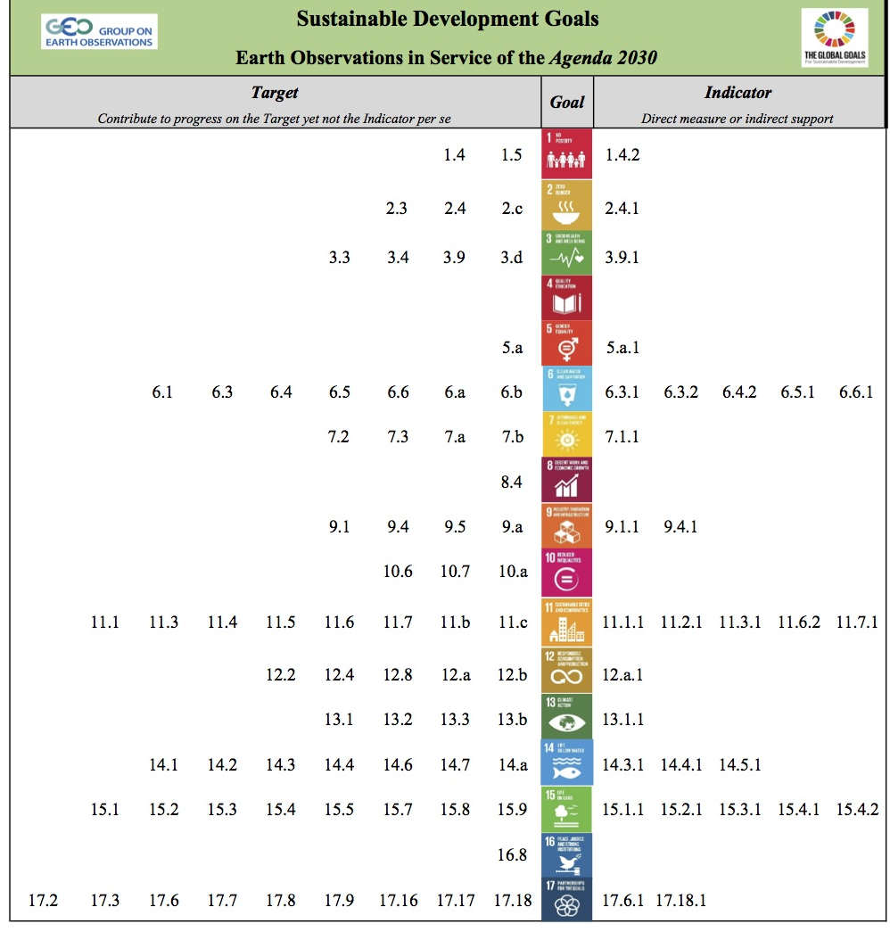






EO4SDG
Alignment of Earth Obs. and GEO to the Goals, Targets, and Indicators
SDGs with most opportunities:

Slide 19
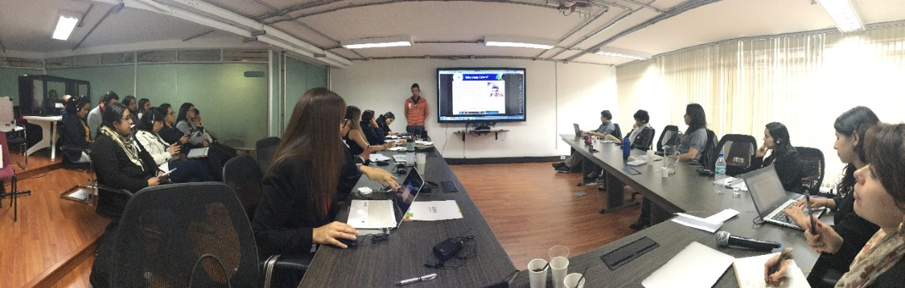
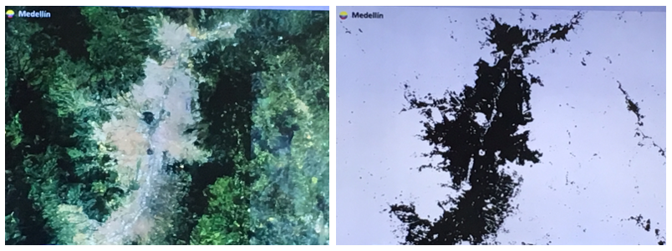
Colombia – Priorities for EO Data
Sustainable cities and urban resilience
Deforestation and forestry management
Land use/cover change
Water resources
Biodiversity
Agriculture
M Paganini, European Space Agency

Slide 20
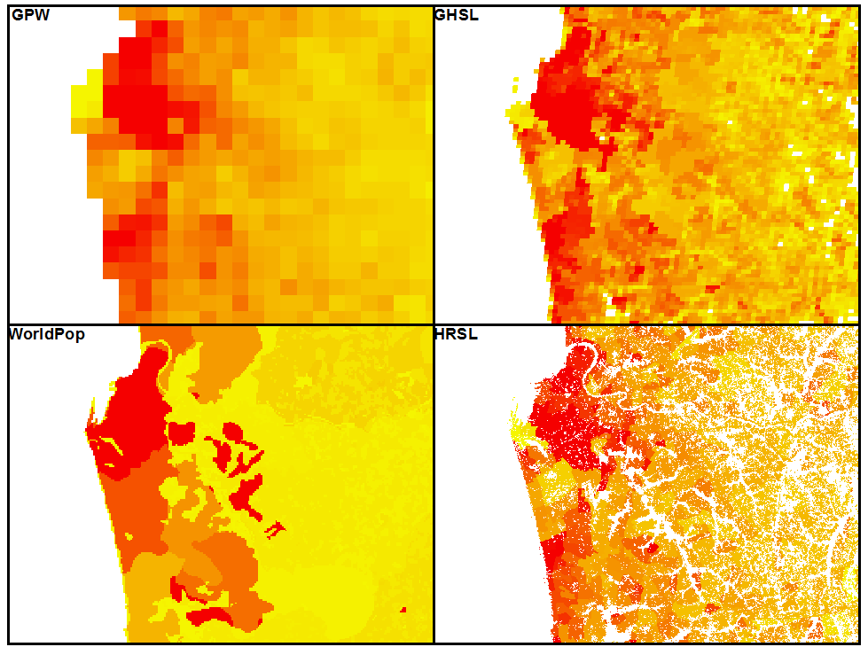
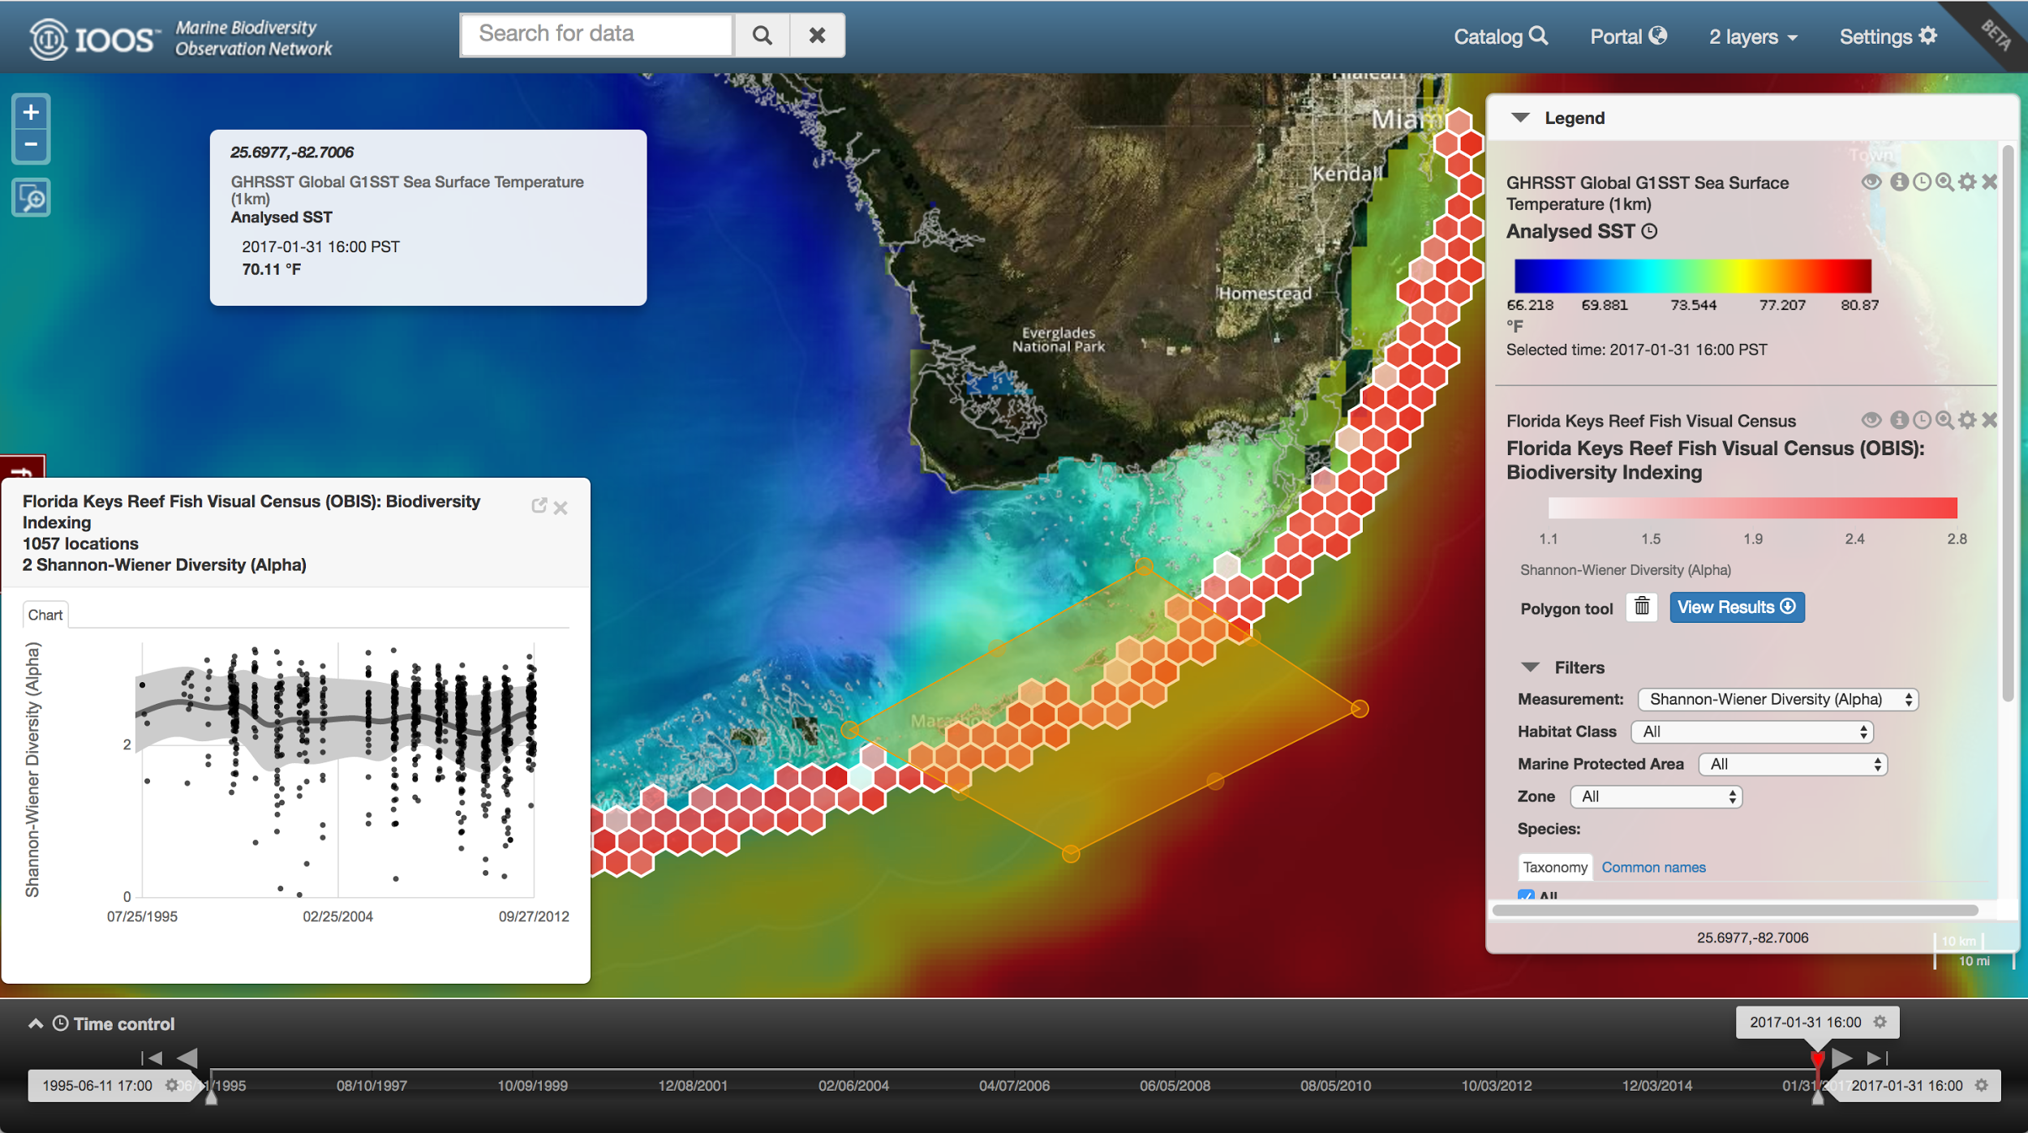
Geospatial/EO Applied to SDG Problems
Alex de Sherbinin, CIESIN
Population estimate results at various resolutions from multiple methods
Frank Muller-Karger, University of S Florda
Marine Biodiversity Observation Network

Slide 21
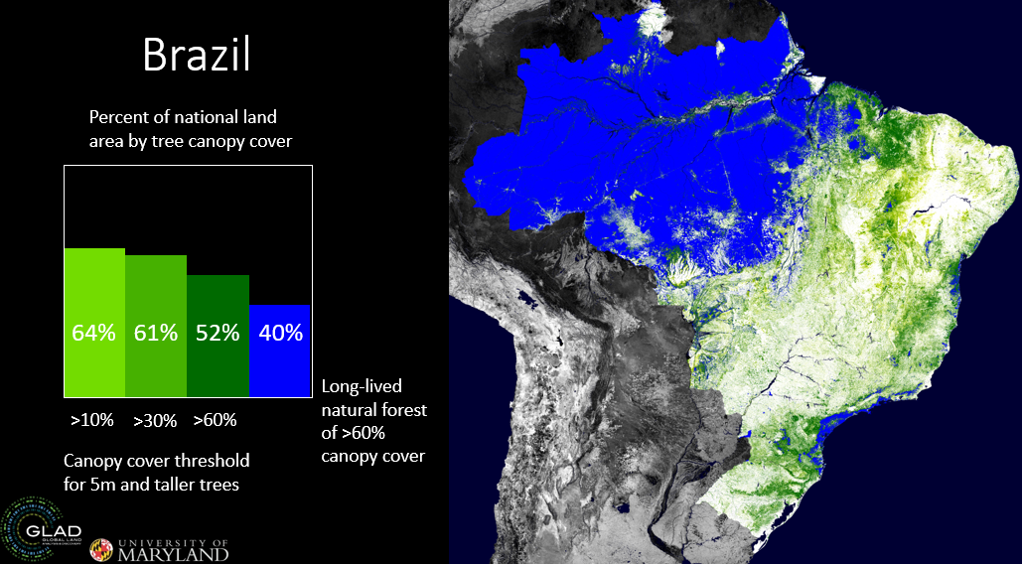
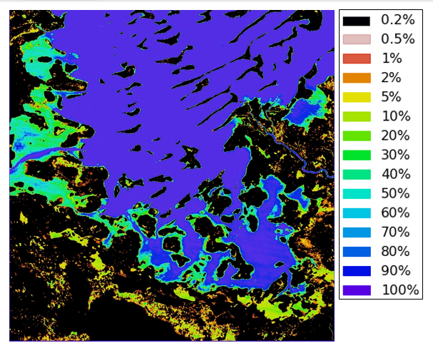
Geospatial/EO Applied to SDG Problems
Matt Hansen, University of Maryland
Percent canopy cover and deforestation mapping
Brian Killough, CEOS/NASA
Data Cubes – Water observations over a 17 year timeframe (Lake Chad,
Cameroon)

Slide 22
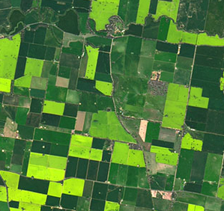


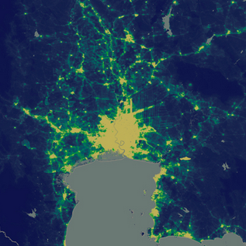
Country Engagement on EO Data
Intergovernmental Network on Open Data for Agriculture and Nutrition
Dynamic and real-time data for smallholder farmers
Establishing data cubes initially focused on a particular thematic issue
Making upcoming population censuses more dynamic and cost-effective
Waste management

Slide 23
Country Level Lessons Learned
INSTITUTIONAL
TECHNICAL
Strengthening institutional cooperation
Engagement with the private sector
Mobilization of funding and resources
Data literacy
Interoperability
Alignment between open data and the SDGs
Data sharing frameworks
New innovation, data and platforms
Environmental data
Geospatial methods

Slide 24
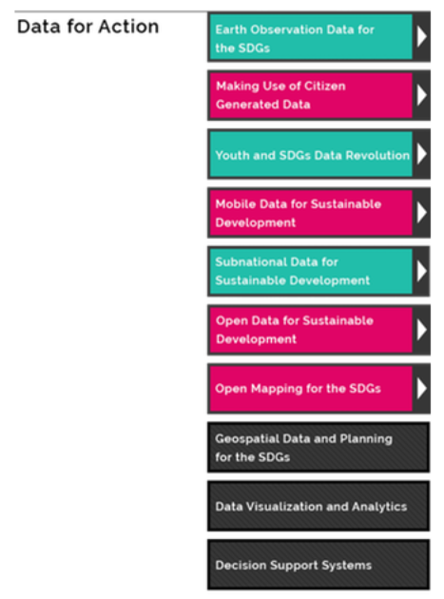
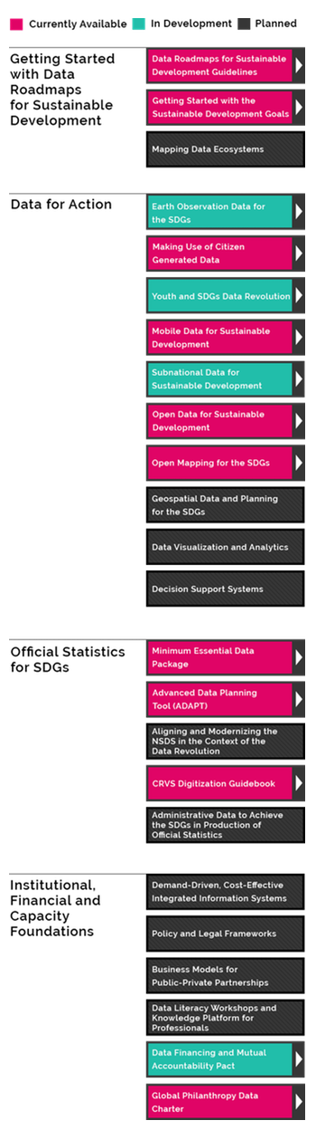
Data4SDGs Toolbox:
Data for Action
http://www.data4sdgs.org/toolbox

Slide 25
apihighways.data4sdgs.org

Slide 26
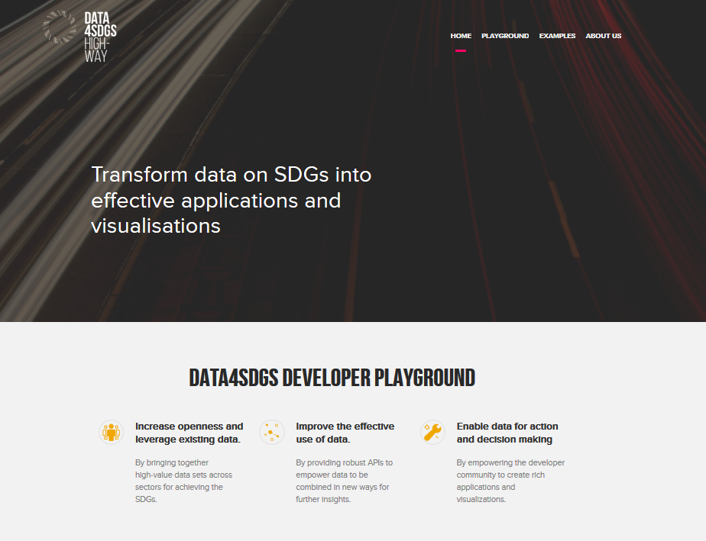

Slide 27
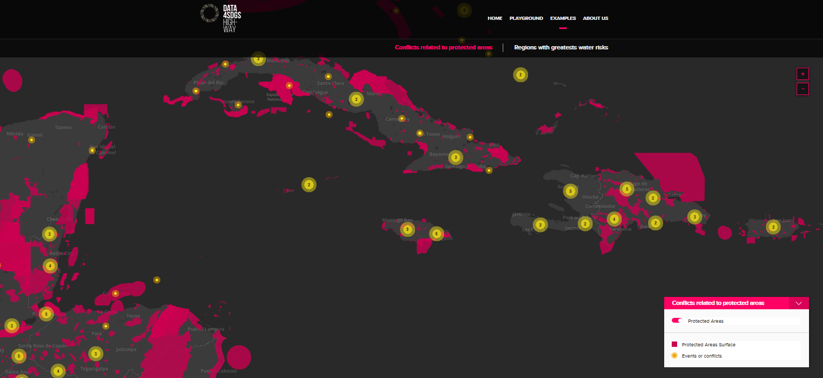

Slide 28
What’s Needed Moving Forward
We must change our normal ways of working, break down silos, and become more collaborative across sectors
We need to embrace innovation and be okay with failure – as long as we learn from it
We need to work at multiple scales bringing national and sub-national planning efforts together in the interest of the SDGs
We need to unlock innovative funding models that are sustainable and develop public-private partnerships that work
Increase data literacy and capacity for data science focused on how data is used for decision making and action

